Slide 1
React – JavaScript Library
Vinoth Kumar M,
Front End Developer.

Slide 2
Why React?
React is a JavaScript library
React allows developers to create large web-applications that use data that can change over time, without reloading the page.
It aims primarily to provide speed, simplicity and scalability.
React processes only user interfaces in applications. This corresponds to View in the Model-View-Controller (MVC) pattern, and can be used in combination with other JavaScript libraries or frameworks in MVC, such as AngularJS.

Slide 3
History
React was created by Jordan Walke, a software engineer at Facebook. He was influenced by Angular and XHP, an HTML component framework for PHP.
It was first deployed on Facebook's newsfeed in 2011 and later on Instagram.com in 2012.It was open-sourced at JSConf US in May 2013.
React Native, which enables native Android, iOS, and UWP development with React, was announced at Facebook's React.js Conf in February 2015 and open-sourced in March 2015.
On April 18, 2017, Facebook announced React Fiber, a new core algorithm of React framework library for building user interfaces.React Fiber will become the foundation of any future improvements and feature development of the React framework.

Slide 4
XHP
XHP is an augmentation of PHP and Hack developed at Facebook to allow XML syntax for the purpose of creating custom and reusable HTML elements.
Facebook have also developed a similar augmentation for JavaScript, namely JSX

Slide 5
Notable features
One-way data flow - Properties, a set of immutable values, are passed to a component's renderer as properties in its HTML tag. A component cannot directly modify any properties passed to it, but can be passed callback functions that do modify values. This mechanism's promise is expressed as "properties flow down; actions flow up".
Virtual DOM - React creates an in-memory data structure cache, computes the resulting differences, and then updates the browser's displayed DOM efficiently.This allows the programmer to write code as if the entire page is rendered on each change, while the React libraries only render sub components that actually change.
JSX - https://angular-2-training-book.rangle.io/handout/features/es6.html , https://babeljs.io/learn-es2015/
ReactJS permits reusing code components – significantly saving time
An open-source library: constantly developing and open to contributions

Slide 6
Introduction
Assumes some familiarity with HTML, CSS, and JavaScript. Knowing what closures are and how "this" works in JavaScript will help but you'll learn React regardless.

Slide 7
Closure
A closure is a function value created from a nested function declaration or function expression (i.e. lambda expression) whose body contains one or more references to variables declared in an outer (but not global) scope.
A closure is an inner function that has access to the outer (enclosing) function's variables—scope chain. The closure has three scope chains: it has access to its own scope (variables defined between its curly brackets), it has access to the outer function's variables, and it has access to the global variables.

Slide 8
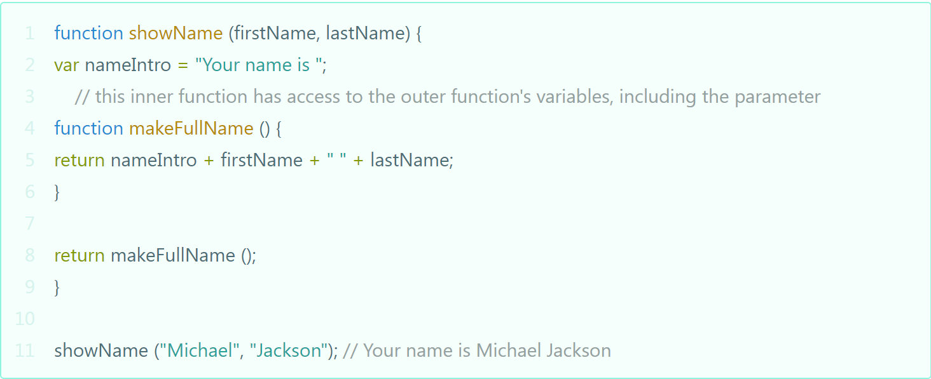
A Basic Example of Closures in JavaScript

Slide 9
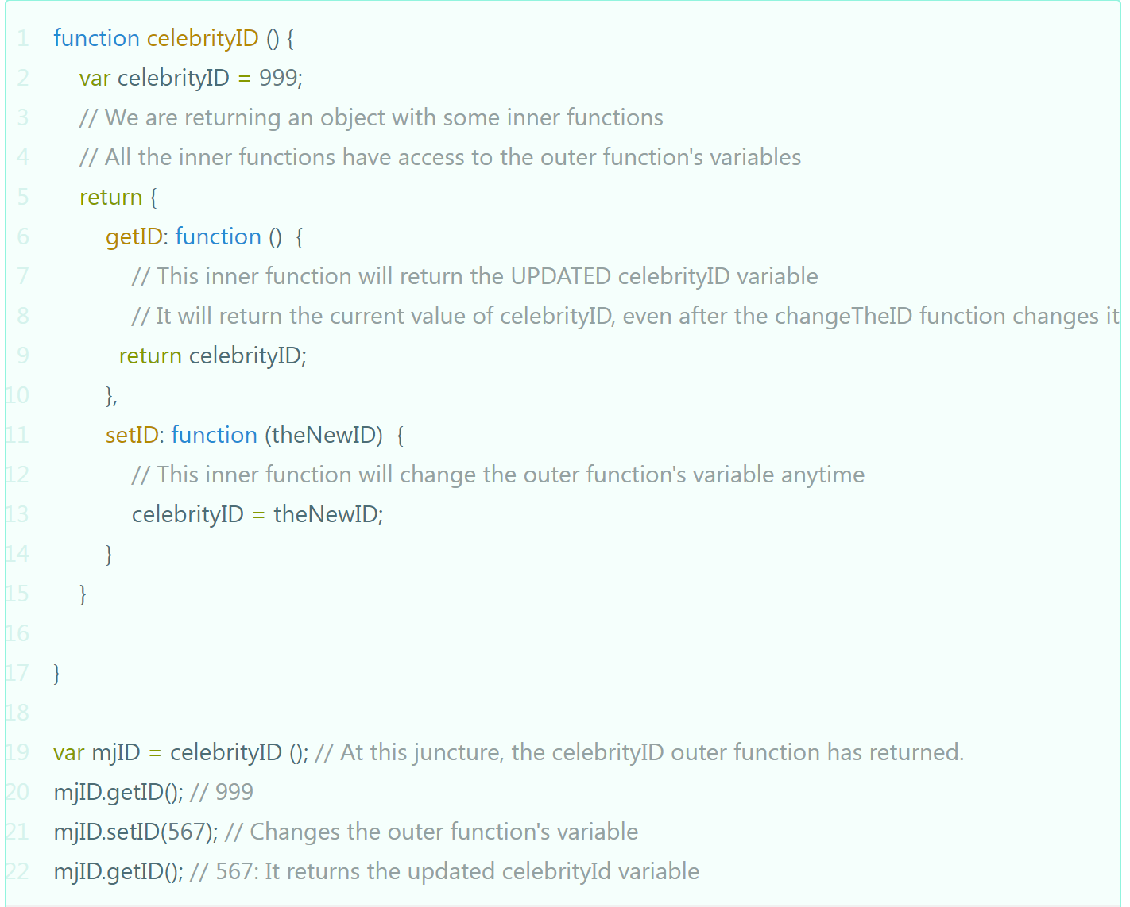
Example of Closures store references to the outer function’s variables:

Slide 10
this
When a function is called with the new operator, this refers to the newly created object inside that function.
When a function is called using call or apply, this refers to the first argument passed to call or apply. If the first argument is null or not an object, this refers to the global object.
https://developer.mozilla.org/en-US/docs/Web/JavaScript/Reference/Operators/this

Slide 11
Let's get started!

Slide 12
To start React
Software & Description : NodeJS and NPM
Step :
Install Global Packages
Add Dependencies and Plugins
Set Compiler, Server and Loaders
Running the Server – APP Start…! (http://localhost:8080/)

Slide 13
JSX
XML in JavaScript
JSX is a preprocessor step that adds XML syntax to JavaScript. You can definitely use React without JSX but JSX makes React a lot more elegant.
Just like XML, JSX tags have a tag name, attributes, and children. If an attribute value is enclosed in quotes, the value is a string. Otherwise, wrap the value in braces and the value is the enclosed JavaScript expression.
http://jsbin.com/maxobehegi/1/embed?js,output

Slide 14
Exercise: Hello
Code in JSX
ReactDOM.render(
<div>Hello!</div>,
document.getElementById('container')
);
Output
http://jsbin.com/ropiwasuwu/1/embed?js,output

Slide 15
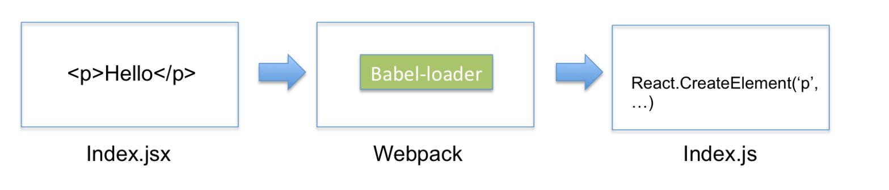
Webpack ,Babel-loader
https://www.codementor.io/tamizhvendan/beginner-guide-setup-reactjs-environment-npm-babel-6-webpack-du107r9zr

Slide 16
Topics to cover react js – basic (Git Branch)
01-setup
02-first-component
03-multiple-components
04-props
05-events
06-state
09-two-way-binding
10-component-lifecycle
11-router
When demo time add refs and keys concept.

Slide 17
Query…..?

Slide 18
Thank You All

